Slide 1

Statistical Measures and Inference
Dr Lee Barnby
School of Computing
7MA505 Statistical Techniques
Week 2, Autumn Semester

Slide 2
Outline
Statistical measures
  Why
  Some definitions
Population Characteristics
  Example
  Central tendency, Dispersion
Histograms
The Central Limit Theorem
Statistical Inference
  Sampling distribution
  Standard error of the mean
Confidence Interval
  Using 𝛔 or s
Student’s t distribution

Slide 3

Statistical Measures
We do we have measures, in any area not just statistics?
What are some terms used to signify relative outcomes?
  Fill the padlet here: https://derbyuni.padlet.org/l_barnby/words-english-that-signify-the-relative-position-or-order-of-b1f6jqm6r82s9gpy

Slide 4
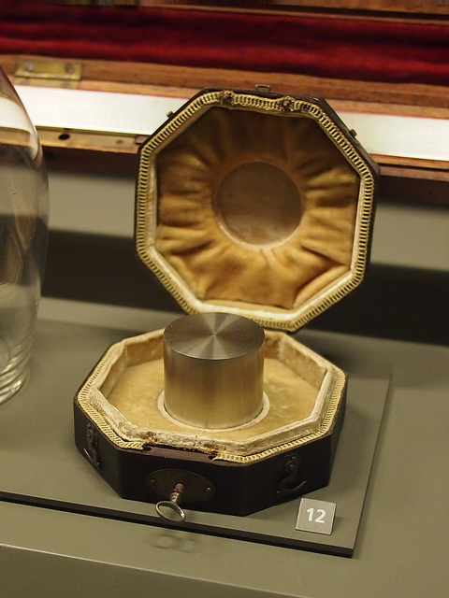

Physical Examples
(Old) kilogramme in Paris
(Former) avoirdupois lengths at Greenwich

Slide 5
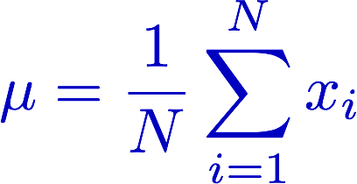
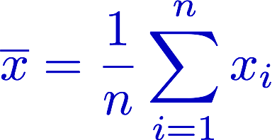
Quantifying populations
n observations, x₁, x₂, …, x_{n} i.e. denoted x_{i} with index i = 1, 2, …, n
The mean, written µ for the population mean and x̅ for the sample mean

Slide 6
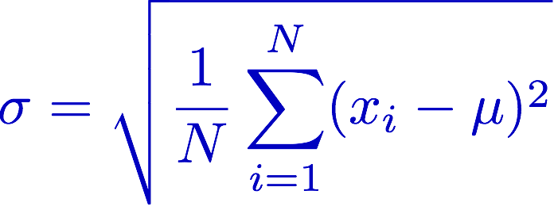
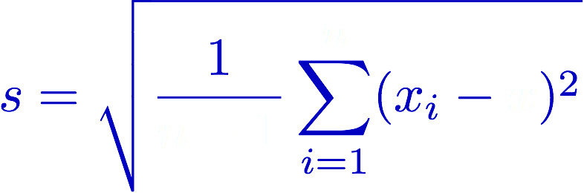
Quantifying populations cont.
The standard deviation, usually written σ for the population and s for the sample
The variance is σ² for the population and s² for the sample
n
_
x
n-1

Slide 7
In practice
You already carried out this calculation in R!
Using sd() function
And also using:
sqrt(sum((mynums - mean(mynums))^2)/(length(mynums)-1))
with mynums suitably defined.
var() function is also available

Slide 8
Population Characteristics
Measures of ‘central tendency’
Mean (we just looked at)
Median – order n values, take central one if n is odd or midpoint between the two middle values if n is even
Mode - the most commonly occurring value
  Be careful, distributions can be unimodal or multimodal

Slide 9
Notes on central tendency
With the median, half of the sample values are above it in value, and half are below it.
  The median is the 50th percentile
If the data is right skewed, then the mean is “inflated”. In such a case the median is not influenced by the small number of very large values.
  E.g. a sampling of salaries.
For the normal distribution, the mean, median and mode are identical.
  This theoretical result can be subject to rounding properties of numbers, and calculation.

Slide 10
Coefficient of variation
Coefficient of variation (CV) or relative standard deviation is the sample standard deviation expressed as a percentage of the mean
  CV = s/ x̅ × 100%
Used to compare dispersion of variable measured with different scales

Slide 11
Measures of dispersion
Includes: range, variance and standard deviation, coefficient of variation or relative standard deviation, inter-quartile range.
Range – simply maximum minus minimum
Sample variance (we considered already)
Why (n-1) degrees of freedom?
  sum of the deviations equals 0, this can be understood to imply that there is a linear constraint
  that in turn means that one of our values can be expressed in terms of all others
  This explains why n − 1 is the degrees of freedom value. And this explains the denominator when calculating s

Slide 12
Histograms
An (empirical) frequency distribution or histogram for a continuous variable presents the counts of observations grouped within pre-specified classes or groups
A bar chart presents the frequencies for a categorical variable
As sample size increases, histogram class widths can be narrowed such that the histogram comes closer to being a smooth curve. Also said to be continuous rather than discrete.
The population histogram of a random variable is referred to as the distribution of the random variable, i.e. it shows how the population is distributed across its overall set of values

Slide 13
Inference - Outline
Statistical Inference
  Sampling distribution
  Standard error of the mean
Confidence Interval
  Using 𝛔 or s
Student’s t distribution

Slide 14
Central Limit Theorem (CLT)
Take a random sample from a population with mean µ and variance 𝛔²
For large sample sizes, the Central Limit Theorem states that
  the distribution of sample means is the normal distribution, with mean µ and variance 𝛔²/n
  i.e. standard deviation is 𝛔/√n
If the original data are normal then the sample means are normal, whatever the sample size

Slide 15
CLT cont.
It tells us the relationship between the sample mean and the population mean
Allows us to perform statistical inference, the extrapolation of sample results to the population
It doesn’t matter what the distribution of the original data is, the sample mean is always normally distributed when n is large

Slide 16
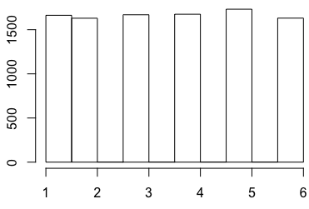
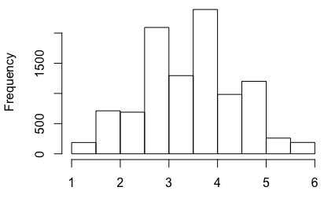
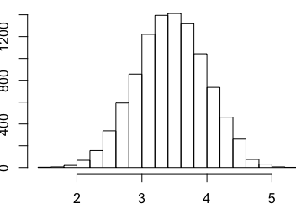
CLT Demonstration
From the dice toss exercise
3 dice averaged
10 dice averaged
1 die
Original distribution far from Normal
Distribution of averages approaches Normal as number of samples (dice) increases

Slide 17
CLT (continued)
It describes the distribution of the sample mean
The values of x̅ obtained by repeatedly taking samples of size n describe a separate population
The distribution of any statistic is often called the sampling distribution

Slide 18
Sampling distribution of x̅
Population mean µ
  Sample 1: x̅₁
  Sample 2: x̅₂
  Sample 3: x̅₃
  …
  Sample k: x̅_{k}
This gives the sampling distribution

Slide 19
Sampling (continued)
The mean of the sampling distribution of x̅ is equal to the population mean
  µ_{x̅} = µ
The standard deviation σ of the sampling distribution of x̅ is the population standard deviation divided by the square root of the sample size
  σ_{x̅} = σ/√n

Slide 20
Standard error
Since s is an estimate of σ, an estimate of σ/√n is
  SE_{x̅} = s/√n
  This is the standard error of the mean
There is a distinction between standard error and standard deviation
  Standard deviation describes the variability of the data
  Standard error describes the precision of x̅ as a measure of µ and σ

Slide 21
What does this imply in practice?
Take repeated samples of size n from a distribution and compute the mean of each sample, this new distribution is called a sampling distribution.
If the original population has mean μ and s.d. σ, the sampling distribution has mean μ and s.d. σ /√n called the standard error of the mean
If the original population has a normal distribution, the sampling distribution is also normal
If the original population is not normal, but does not have “excessively long” tails, the sampling distribution can be approximated by a normal distribution for large samples (≥ 30)

Slide 22
Are my data normal?
How can you tell whether your data are normally distributed?
Various tests can be done
  Normal probability (Q-Q) plot
  Box plot
  Histogram
  Shapiro-Wilk test
Better to explore these with R in the next tutorial

Slide 23
Confidence Interval
A confidence interval for a population characteristic is an interval of plausible values for the characteristic. It is constructed so that, with a chosen degree of confidence (the confidence level), the value of the characteristic will be captured inside the interval.
  E.g. we claim with 95% confidence that the population mean lies between 15.6 and 17.2
Generally, this is a type of interval estimate

Slide 24
Confidence Interval:
Sample Mean when Variance is Known
A 95% confidence interval for x̅ if σ is known is given by
  x̅ ± 1.96 x σ/√n

Slide 25
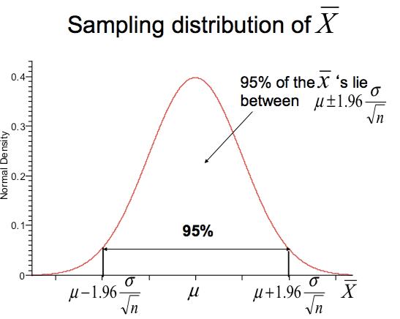
Let’s picture this

Slide 26
Example
A random sample of 80 tablets had an average potency of 15mg. Assume σ is known to be 4mg.
  x̅ = 15, σ = 4, n = 80
A 95% confidence interval for x̅ is:
  15 ± 1.96 ⨉ 4/√80 = {14.12, 15.88}
Doing this in R:
  qnorm(0.025, mean=15, sd=4/sqrt(80))
  Gives: 14.12348
  qnorm(0.975, mean=15, sd=4/sqrt(80))
  Gives: 15.87952

Slide 27
Confidence Interval when σ is unknown
Almost always the case that σ is unknown and has to be estimated using the sample standard deviation s
The value 1.96 in the confidence interval is replaced by a new quantity, denoted t_{0.025}
The 95% confidence interval for an unknown σ is
  x̅ ± t_{0.025} x s/√n

Slide 28
Student’s t Distribution
William Sealy Gosset published this distribution in 1908. He was working in Guinness’s brewery in Dublin. He published with the pseudonym, Student.
Closely related to the standard normal distribution Z
  Symmetric and bell-shaped
  Has a mean = 0 but has a larger standard deviation
Exact shape depends on a parameter called degrees of freedom (df) which is related to the sample size
  In this context df = n - 1

Slide 29
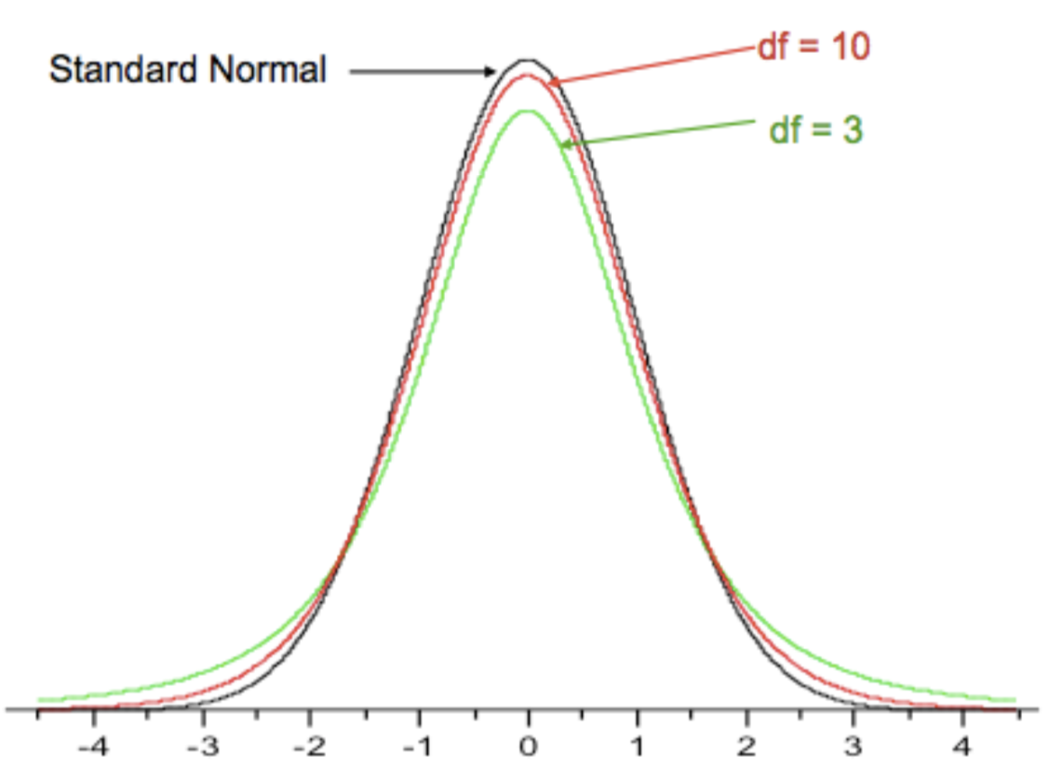
Comparing Normal and t distributions

Slide 30
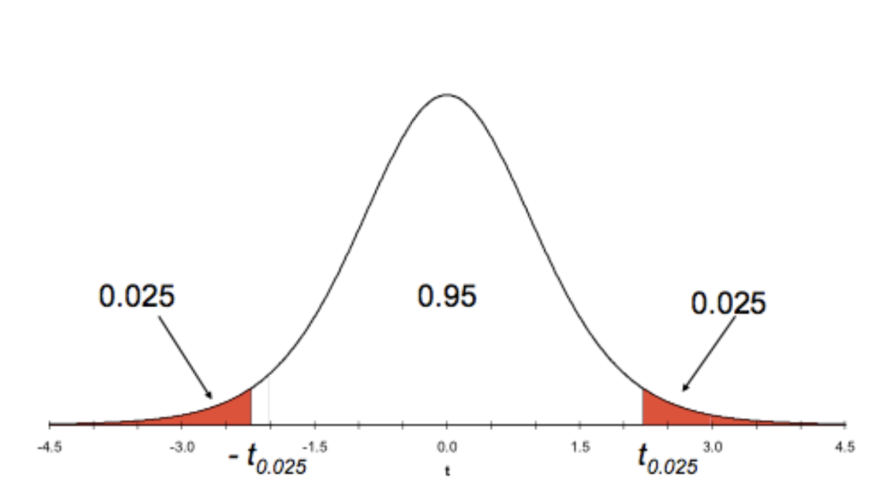
Definition of t_{0.025} values

Slide 31
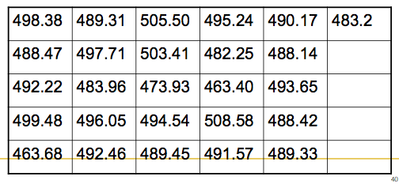
Example
x̅ = 490.96, s = 10.783 mg per tablet
t_{0.025} for df = 25 is 2.06
So x̅ ± t_{0.025} × s/√n = 490.096 ± 2.06 × 10.783/√25
= 490.096 ± 4.44
Batch potency lies between 485.6 and 494.54 mg per tablet.
26 measurements of the potency of a single batch of tablets in mg

Slide 32
Summary
Statistical measures and population characteristics
Utilising the Central Limit Theorem
The Normal and Student’s distribution properties

Slide 33
Supplementary Material
Random number generation

Slide 34
Random numbers in practice
Random number generators produce pseudo-random numbers.
Usual steps are:
  generating uniformly distributed random values in [0,1]
  the uniformly distributed values are transformed to the desired distribution
From the uniformly distributed values, by a specific transformation, we can transform the values into normally distributed, and independent values
The same principle holds for other distributions
  Having an empirical cumulative distribution function (discussed later), we can transform the uniformly distributed values to our target distribution

Slide 35
Random numbers in practice cont.
Standard approach is using a linear congruential generator
Simple example: x_{n} = (5x_{n−1} + 1) mod 16
For x₀ = 5:
Gives x_{i} ∈[0,15] for all i
Divide each x_{i} by 15 yields random numbers in the interval [0,1]
Desired general properties:
  seed value, statistical tests for randomness are passed, sequence is reproducible, successive values are independent, uniformly dist

Slide 36
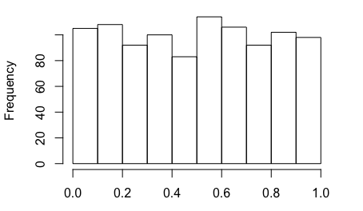
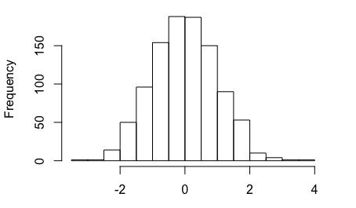
From tutorial – random distributions
Randomly generated distributions with runif() and rnorm()

Slide 37
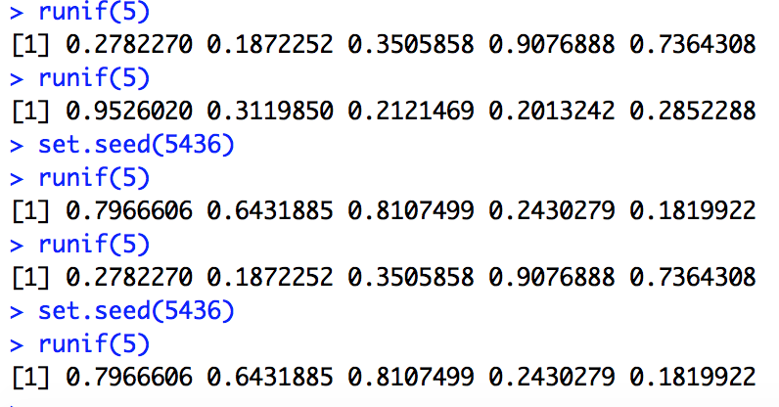
From tutorial – random seeds
Random number sequences are different each time
Unless you set the seed
And then only that time
This behaviour in R is best / most convenient but other languages / environments my work differently

Slide 38
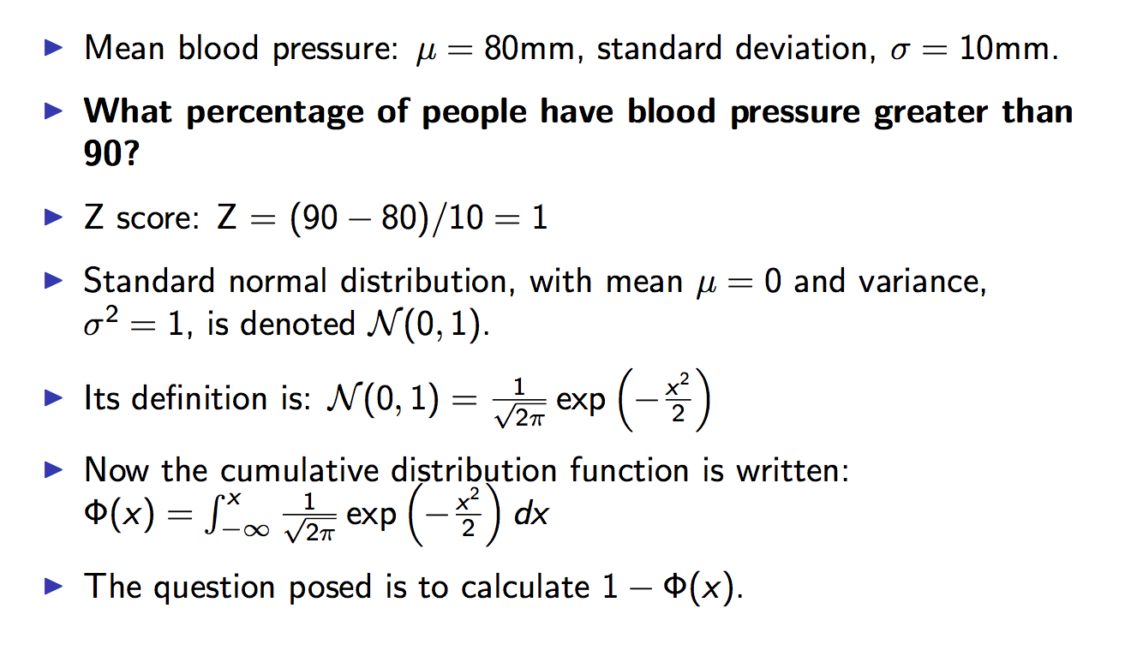
From tutorial – problem solving with pnorm()
> pnorm(1,0,1)
[1] 0.8413447
> pnorm(90,80,10)
[1] 0.8413447
> pnorm(90,80,10,FALSE)
[1] 0.1586553

